Slide 1
Emergency nodes with distributed database
Members:
Rivera, Benjamin
Tonoike, Tomio
Tison, Alfonsin
Ellana, Allen
Project Adviser:
Mr. Paolo Oblepias
Project Professor:
Mr. Manuel Sebastian

Slide 2
I. Introduction
Background of the Problem
Main inspiration: Typhoon Yolanda
Two days to restore telco services in Tacloban
Two weeks or more in more remote areas
Lack of communication is a problem for disaster recovery
Voice call (Walkie-talkie and satellite phones)
Not all places in the Philippines is covered by telco services (mining sites, rural areas)

Slide 3
I. Introduction
Background of the Problem
Average citizens will not be able to use the proposed solution without some networking knowhow
A variable mesh network will not be able to handle centralized data storage
Single Point of Failure
Reduction of Performance and Availability

Slide 4
I. Introduction
Statement of the Problem
What is a possible way of creating a communications system that can easily be deployed during post-disaster scenarios and are cost effective
How can the requirements of a post-disaster communication system built on E-Nodes be fulfilled while maintaining the scalability, accessibility and reliability of the network.

Slide 5
I. Introduction
Main Objectives
This study aims to find a cost efficient and easily deployable method to improve the communication among users of Wi-Fi capable mobile devices who are situated in a place where there is no currently available network infrastructure to connect to.
Is the implementation of distributed databases in Raspberry Pis is an effective method to create an easily implemented and scalable emergency wireless mesh communications network.

Slide 6
I. Introduction
Specific Objectives
To connect multiple microcomputers as intermediary nodes of a mesh network;
To connect mobile devices to the nodes of the network;
To enable data transfer between nodes;
To relay a message to and from endpoints of the network (smartphones);
To enable the network nodes to automatically detect and connect to nearby nodes;
To design a software solution that will effectively comply with the needs of disaster recovery personnel;
To design and develop a web application that will be hosted on the microcontrollers that has basic chat functions and mapping services;
To create a solution that will be cost effective.

Slide 7
I. Introduction
Significance
Can be offered to OCD as a potential solution that can be used by rescue teams
Flexible system
Some hardware parts are modular
Network is configurable
Available applications that depend on the same technology can be used (i.e. Walkietooth)
Database replication can be optimized depending on the usage

Slide 8
I. Introduction
Significance
Communication tool
Can save cost and time from improper provision
Save human lives
Visualization is important
Live-Video feed / Mapping Software
Technology is not currently being maximized to improve planning

Slide 9
I. Introduction
Scope and Limitations
Use and modify existing technologies
Use Raspberry Pi 3 Model B
Testing is limited to 3 Pis due to budget constraints
Android smartphones for testing
Web application developed using Laravel and back-end API’s using Django
Apache Cassandra as DDBMS
Security is limited to WPA2 and Laravel features

Slide 10
I. Introduction
Scope and Limitations
Actual implementation is not included
Tested in simulated environments: line of sight (open space), obstructed (urban environment)
Power consumption not discussed

Slide 11
II. Related Literature
Wi-Fi Peer to Peer and Ad-hoc network apps
No AP
Fire Chat
-”peer-to-peer” chat app
-uses Bluetooth and Wi-Fi Direct to send messages
-not platform dependent
-free but not open source

Slide 12
II. Related Literature
Mobile Ad-hoc Networks (MANET)
Interconnected nodes
All nodes are routers
Ad-hoc – private network
Mobile – ever changing structure

Slide 13
II. Related Literature
Which device to use?
Arduino
Raspberry Pi

Slide 14
II. Related Literature
Arduino
PROS
Cheap
Lightweight / easily replaceable
Easily available
Easy to use
Wide range of modules can be added
CONS
Very low memory
Operating system
Inefficient data transfer

Slide 15
II. Related Literature
Raspberry Pi
PROS
Flexible
Lightweight
Has built in 802.11 and Bluetooth modules(Rasberry Pi 3)
Wide range of modules can be added
Has functions of a computer
CONS
More expensive than microcontroller
No official distributor in the Philippines

Slide 16
II. Related Literature
Google removed ad-hoc mode feature from API14 above
No more MANET

Slide 17
II. Related Literature
Wireless Mesh Network (WMN)
Like MANET but not mobile
Interconnected nodes
Mesh vs. star network -all devices are just connected to a central device.

Slide 18
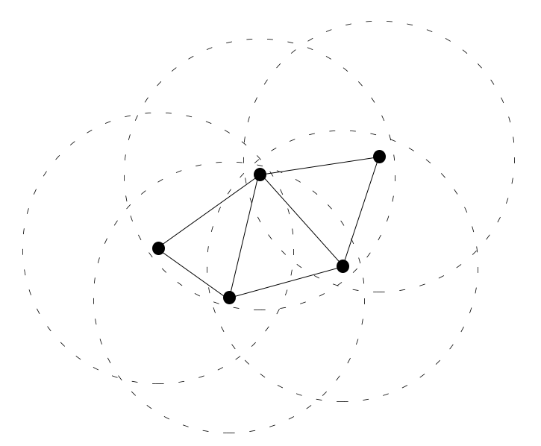
II. Related Literature
Wireless Mesh Network (WMN)

Slide 19
II. Related Literature
Wireless Access Points (WAP)
hostapd – turn Wi-Fi dongle to WAP
Drivers of Wi-Fi dongles have compatibility issues with Pi
Tenda W311U/+

Slide 20
II. Related Literature
Mobile Application
Or
Web Application

Slide 21
II. Related Literature
Mobile application
Needs to be installed before deployment – limited number of nodes
Needs to be constantly updated

Slide 22
II. Related Literature
Web application
Accessed through web browser – can be used by anyone who is inside the network
People know how to visit websites

Slide 23
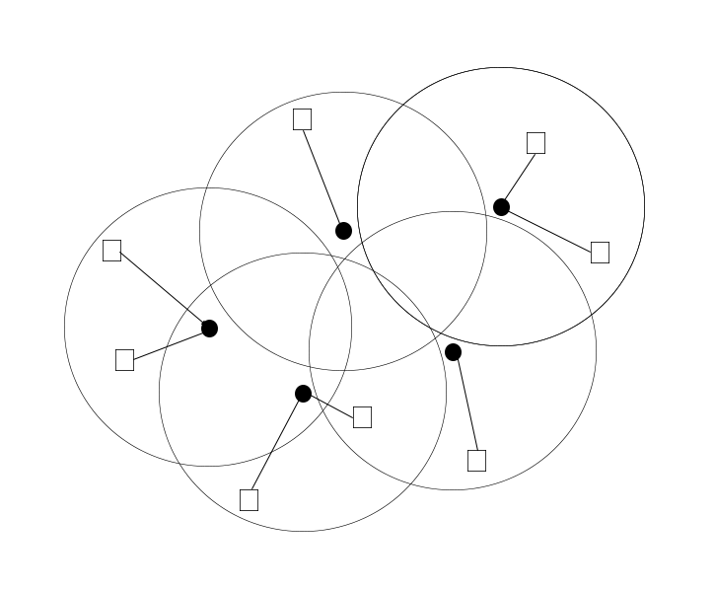
II. Related Literature
System
Mesh Star

Slide 24
II. Related Literature
Distributed Database
To ensure data localization, availability, and consistency
Usually used in handling big data
Implements data replication

Slide 25
II. Related Literature
Related projects
Byzantium
-based on a Linux distribution (Porteus Linux)
-connects multiple devices using 802.11 wireless interface
-can be run on Raspberry Pi
-Also use OLSR
-Discontinued due to Google not supporting
Ad-hoc mode on their devices

Slide 26
II. Related Literature
Related projects
Serval Mesh
-currently in development project
-created their own mesh network by placing devices at strategic places
-users can send messages, call, and send files (including Serval apk) to people within their network
-Same limitations as any mesh topology

Slide 27
III. Theoretical Background
Wireless Mesh Network
Star vs Mesh
Fast / Scalable
Self-organizing
Multi-hop communication
Sends data through routing protocols
In our system, each node will act as an access point

Slide 28
III. Theoretical Background
Distributed Databases
Data is not stored in a single location
Data replicaiton
Master/Slave
Masterless
Primary Owner

Slide 29
III. Theoretical Background
AODV (Distance Vector)
On Demand
OLSR (Optimized Link State Routing)
Maps the whole network using heartbeat mechanism

Slide 30
III. Theoretical Background
Raspberry Pi 3
Cost-efficient
Lightweight
Has an Operating System
Can act as a PC router
Has 4 USB ports
1 GB RAM

Slide 31
IV. Design and Methodology
Components
Rpi 3 Model B (32 Bit ARM)
Wi-Fi Dongle (Tenda W311u+)
MicroSD Memory Card (Class 10)
Battery Pack (Powerbanks)

Slide 32
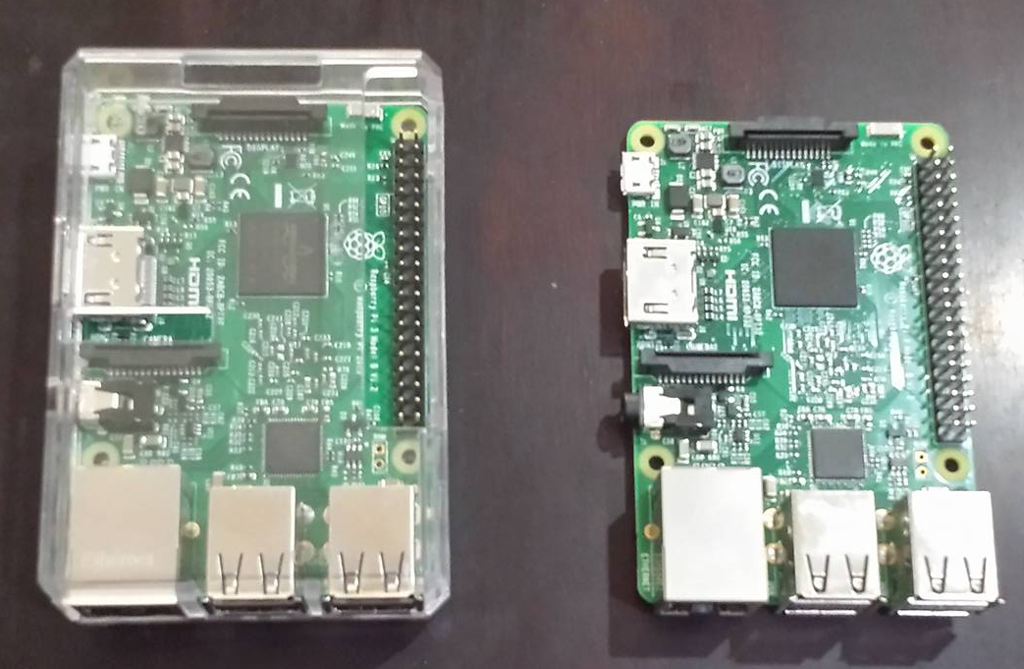
IV. Design and Methodology
Figure 1. Raspberry Pi 3 Model B (With and without case)

Slide 33
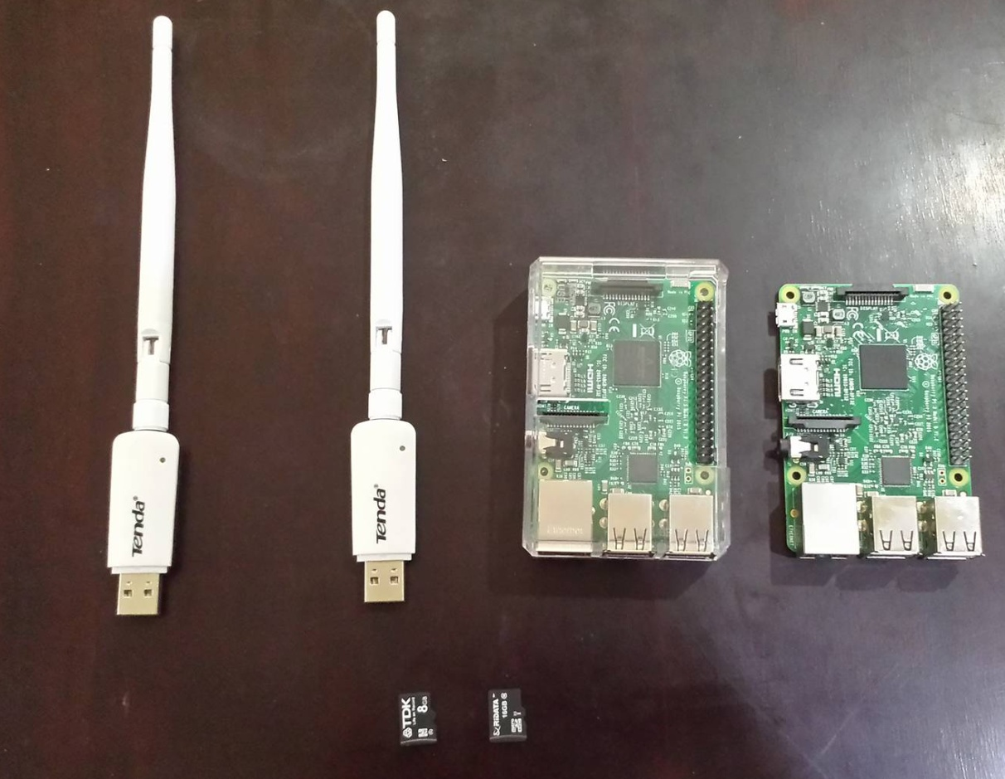
IV. Design and Methodology
Figure 2. Components for the Node

Slide 34
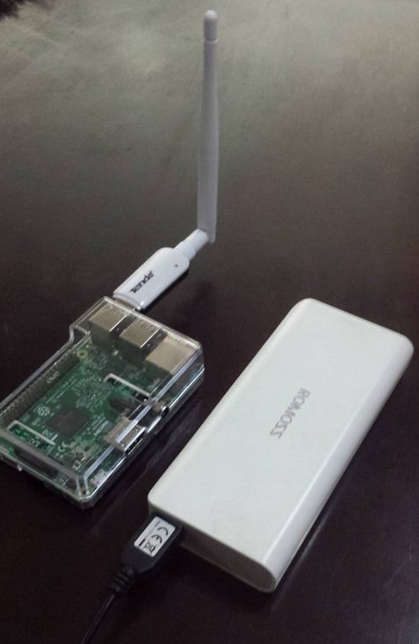
IV. Design and Methodology
Figure 3. Assembled Node with Battery Pack

Slide 35
IV. Design and Methodology
Software Used in the Creation of the E-Nodes
Ubuntu 16.04 – Operating system
Hostapd – Daemon to handle access point
Olsrd – to establish the Mesh network
Dnsmasq – Handles the DHCP and DNS configurations
Software Used in the Creation of PDECS
Laravel Framework w/ datastax driver – PHP chat
Django Framework w/ datastax driver – API
Datastax Enterprise (Apache Cassandra) – NoSQL DDBMS
QGIS / QGIS Server – Customization of Downloaded Map / Hosting
IDE’s Pycharm and

Slide 36
IV. Design and Methodology
Steps (E-Nodes)
Sourcing of Hardware
Assembly
OS installation
Olsrd Setup (w/ Testing)
Dnsmasq Setup (DHCP/DNS)
Hostapd Setup
NAT setup / Port-forwarding
Routing Tables
On-boot configuration
End Device to End Device Tests

Slide 37
IV. Design and Methodology
Steps (PDECS)
Datastax Enterprise Download and Installation
Laravel download and PHP Chat Development
Django API development
QGIS Download and Installation
Sourcing of Map Data and Designing using QGIS
Customization of QGIS Client / Map Interface
Unit Testing
Integration of All Units
System Testing / Usability Testing

Slide 39
Testing
Metrics
E-Nodes
ping, TCP throughput, UDP throughput, Packet Delay Variation (also known as jitter) and error rate
PDECC
Usability Testing
Unit Tests

Slide 40
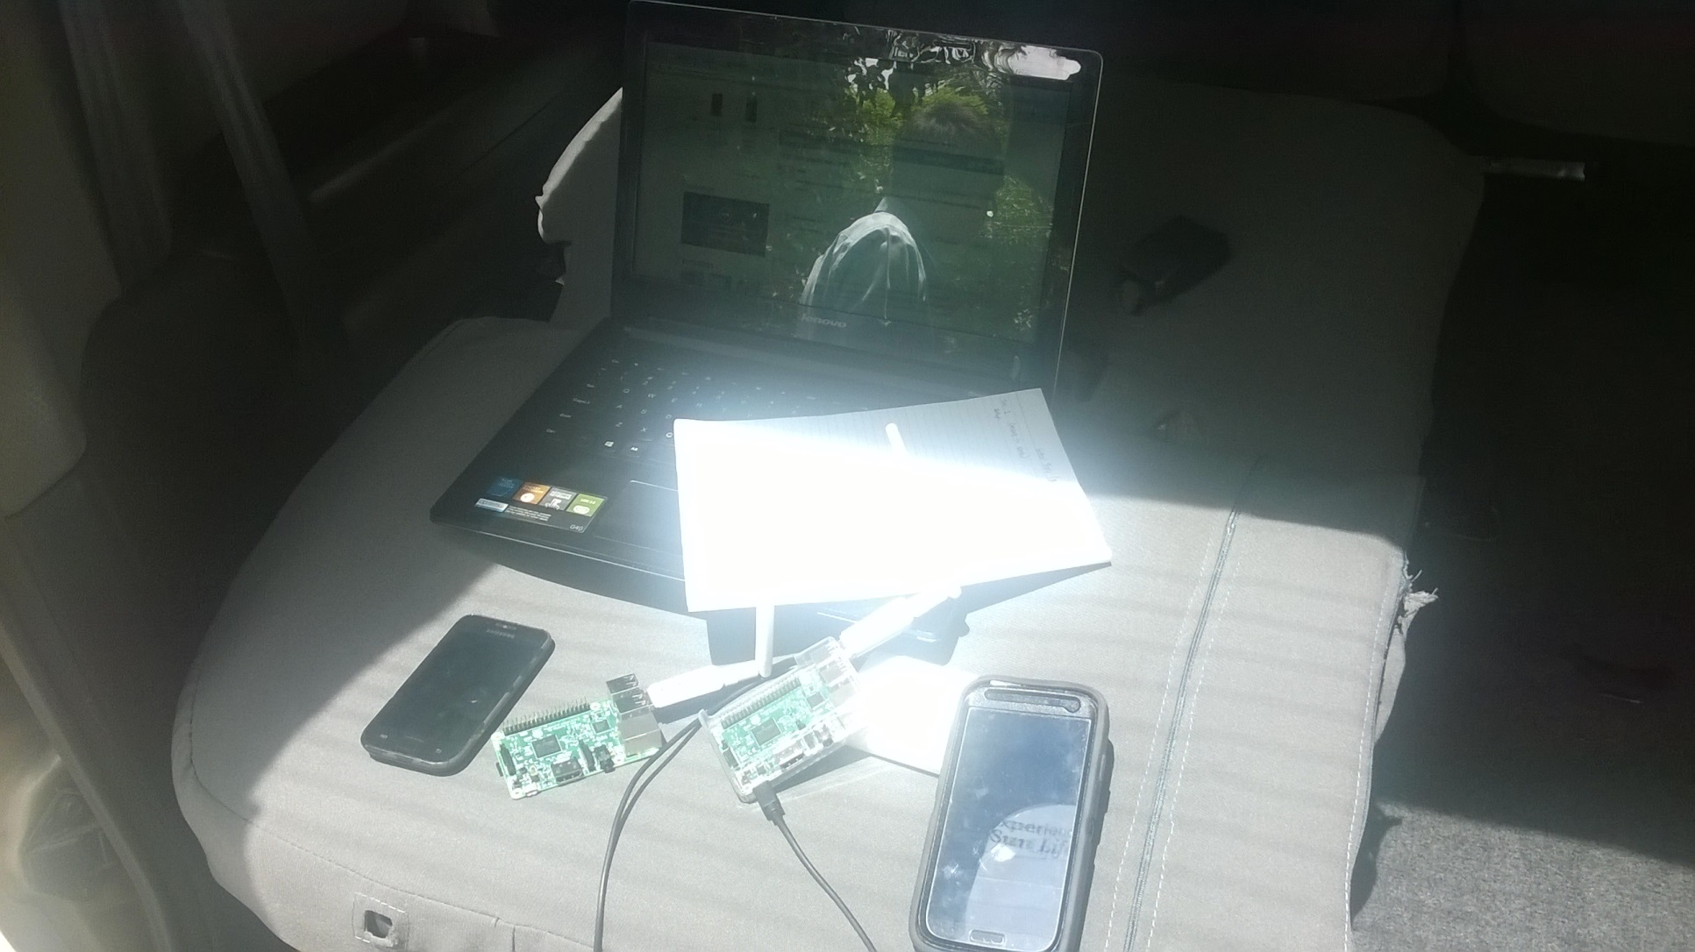
Figures
Figure 4. Outdoor Setup

Slide 41
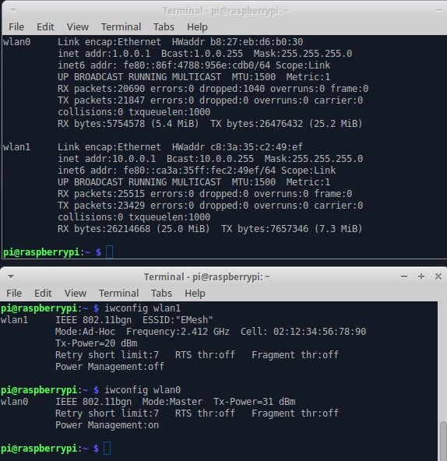
Figures
Figure 5. Node 1 Network Setup

Slide 42
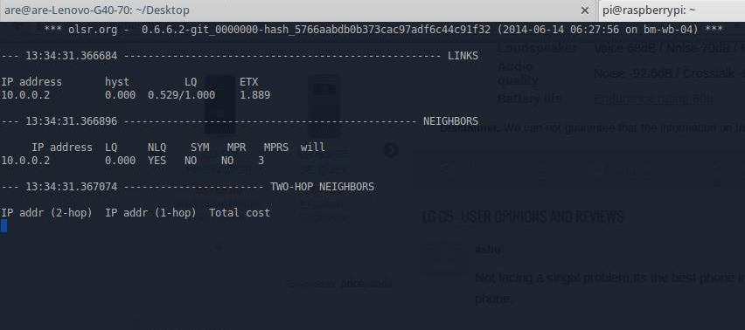
Figures
Figure 6. OLSRDd

Slide 43
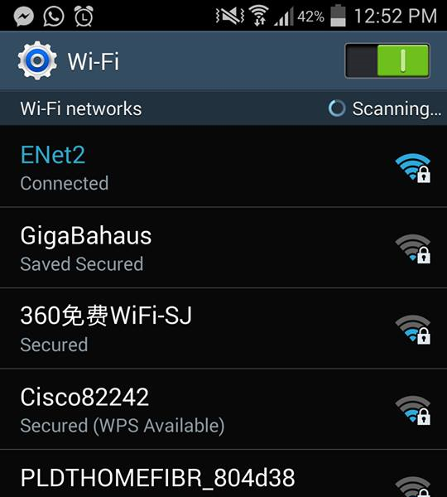
Figures
Figure 7. ENet2 Access Point

Slide 44
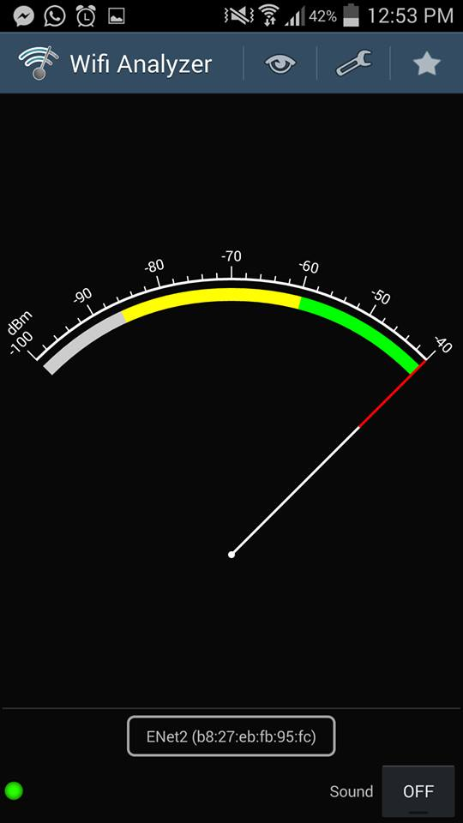
Figures
Figure 8. ENet2 Access Point Wifi Analyzer

Slide 45
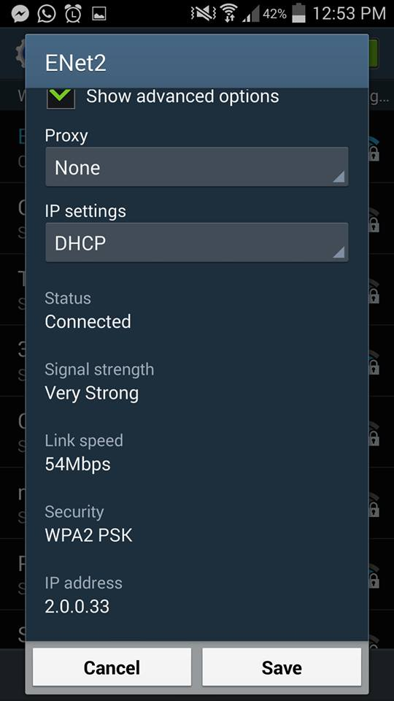
Figures
Figure 9. ENet2 DHCP

Slide 46
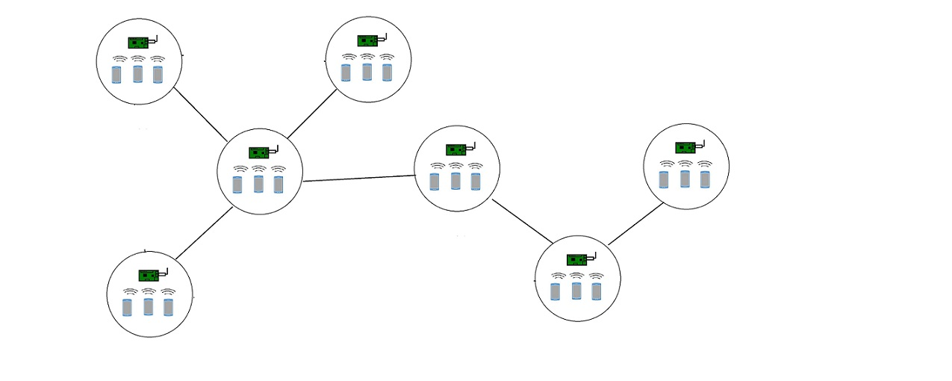
Network Architecture

Slide 47
OUTDOOR TESTS

Slide 48
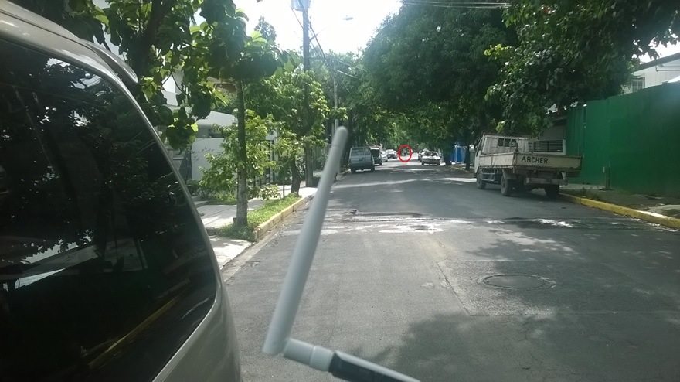

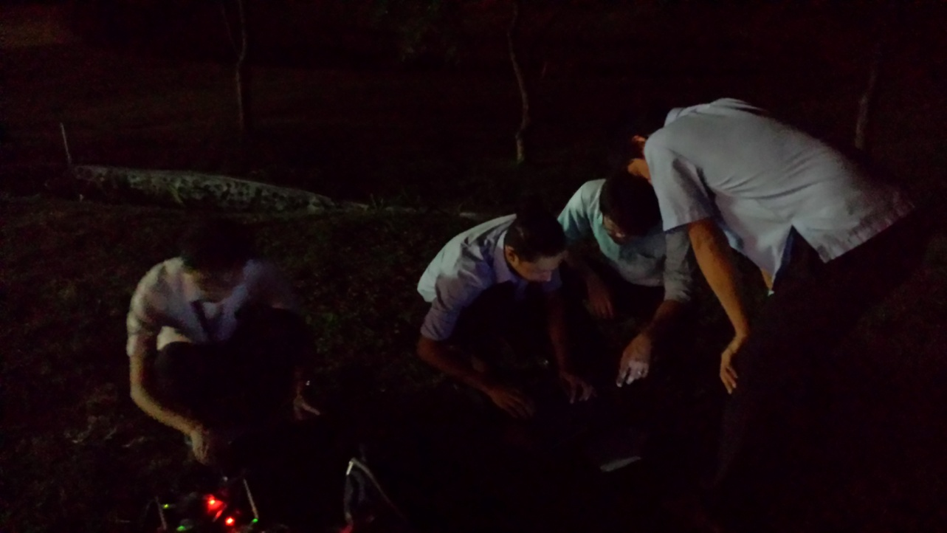
Testing

Slide 49
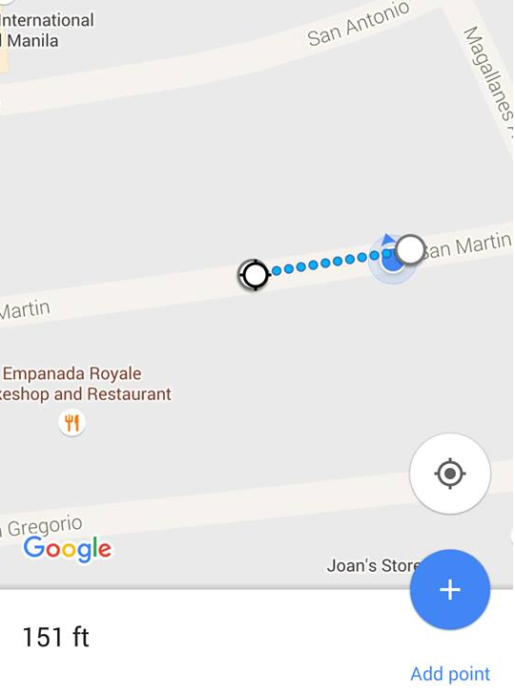
Results
Figure 1. Range of Camera Share (Device-Node-Device)

Slide 50
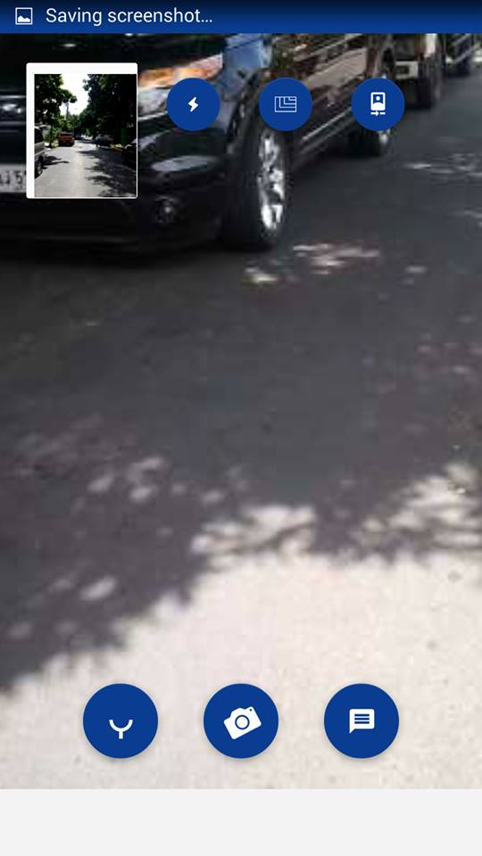
Figure 2. Figure 1 Actual Picture

Slide 51
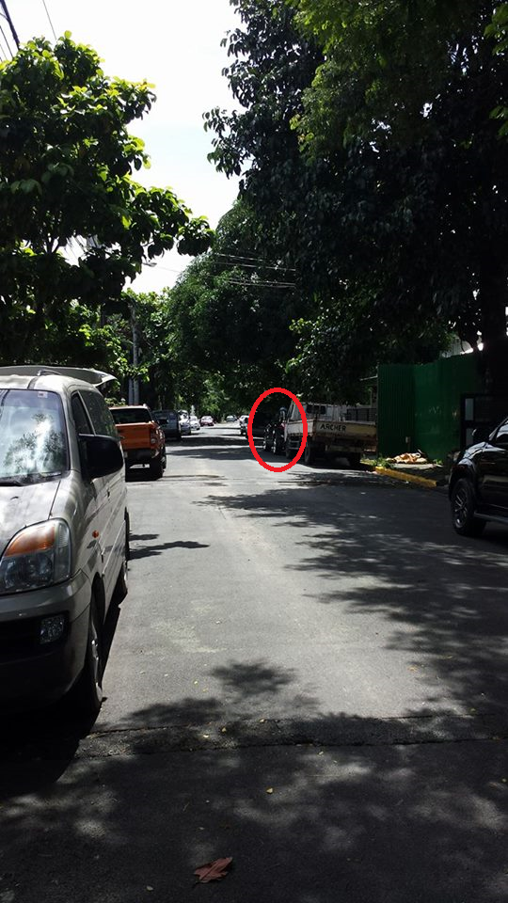
Figure 3. Figure 2 Relative from Other Viewer

Slide 52
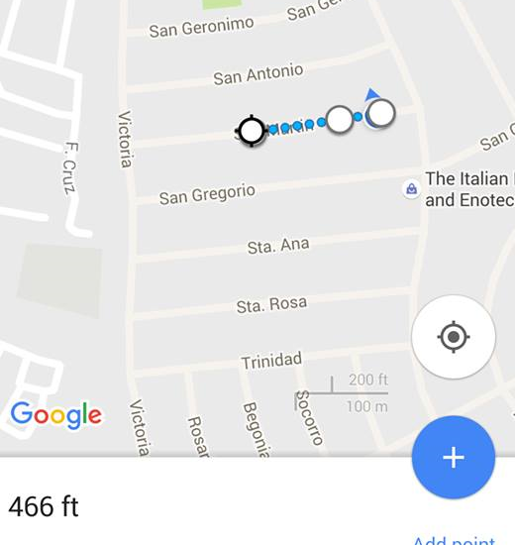
Results
Figure 4. Range of Voice Call (DND)

Slide 53
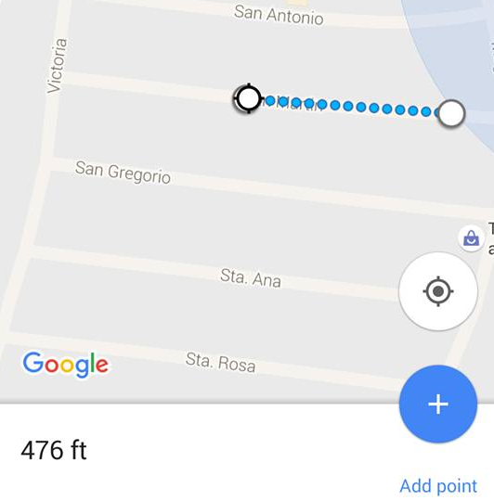
Results
Figure 5. Range of Voice Call (DNND)

Slide 54

Figures
Figure 6. Figure 5 Actual Photo

Slide 55
LIVE DEMONSTRATION

Slide 56
Results and Discussion
Maximum Effective Range of 380 (Open Space)
There is a significant drop in the throughput values after the 300m mark.

Slide 57
Conclusion
Three Raspberry Pis were able to connect to each other forming a small WMN. The performance and range shows that is a viable option of deploying an emergency network. It is also cost efficient.
The concept of applying distributed database fulfills all the requirements of an emergency communication system but it is more advisable for mesh nodes with more memory.

Slide 58
For further validation
Test Cases
Different Mobile Devices (also backwards compatibility)
Different Routing Protocols (BATMAN/Babel/OLSR/AODV)
Multi-hop Routing (For scalability)
Simulated Environment:
Forest / Variable Elevation / Levelled Areas
With both Sunny / Rainy conditions

Slide 59
Recommendations
There could be cheaper alternatives to Raspberry Pi 3
Improve and add more functionalities to the PDECS
Test different Wi-Fi components based on:
Power
Antennae size
Price
Create a case that will protect it from the elements taking into consideration the heat management and signal blocking

Slide 60
Recommendations
Research the optimal deployment method and best antennae type for that method (Sector vs Omni-Directional)
Optimization of the Distributed Database
Try to integrate a Positioning System (GPS)
Minimize Power Consumption
By reducing consumption in software / hardware level

Slide 61
References
Bourque B. (2015). Arduino vs. Raspberry Pi: Mortal Enemies, or Best Friends? Retrieved on March 10, 2016/ http://www.digitaltrends.com/computing/arduino-vs-raspberry-pi/
Schmidt A., Häkkilä J., Rukzio E., Atterer R. (2006). Mobile Phones as Tool to Increase Communication and Location Awareness of Users. Retrieved on August 10, 2016/https://www.medien.ifi.lmu.de/pubdb/publications/pub/schmidt2006ieemobility/schmidt2006ieemobility.pdf
Krag T., Büettrich S. (2004). Wireless Mesh Networking. Retrieved on March 10, 2016/ http://archive.oreilly.com/pub/a/wireless/2004/01/22/wirelessmesh.html
Ciarlone J. (2015). Wireless Mesh Networking: Recommended Maximum Distances. Retrieved on March 20, 2016/ http://info.hummingbirdnetworks.com/blog/wireless-mesh-networking-recommended-maximum-distances
Ishfaq M. (2014). Comparative Analysis of Ad Hoc Routing Protocols in Wireless Mesh Network Environment. Retrieved on March 20, 2016/ http://www.idosi.org/wasj/wasj29(3)14/14.pdf
GSMA Intelligence (2014).Country Overview: Philippines Growth through innovation. Retrieved on March 20, 2016/ https://www.gsmaintelligence.com/research/?file=141201-philippines.pdf&download
Project Byzantium (2011). Retrieved on July 23, 2016/ http://project-byzantium.org/
Woodford C. (2016). How Cellphones Work. Retrieved on July 10, 2016/ http://www.explainthatstuff.com/cellphones.html
Mullen J. (2013). Super Typhoon Haiyan, One of Strongest Storms Ever, Hits Central Philippines. Retrieved on March 9, 2016/ http://edition.cnn.com/2013/11/07/world/asia/philippines-typhoon-haiyan/
Roberts E. (December 2006). RISC Architecture. Retrieved August 19, 2016/ https://cs.stanford.edu/people/eroberts/courses/soco/projects/risc/whatis/index.html

Slide 62
References
Kozierok C., 2005, The TCP/IP Guide, http://www.tcpipguide.com/free/t_OverviewOfKeyRoutingProtocolConceptsArchitecturesP.htm. Retrieved August 16, 2016.
Perkins & Royer, 2003, https://www.cs.cornell.edu/people/egs/615/aodv.pdf, Retrieved August 16, 2016.
Cisco Networking Academy, 2014 http://www.ciscopress.com/articles/article.asp?p=2180210&seqNum=4, Retrieved August 16, 2016.
Thomas J., 2008 http://www.omnisecu.com/cisco-certified-network-associate-ccna/introduction-to-link-state-routing-protocols.php, Retrieved August 17, 2016.
Alberghetti, D, 2015 http://www.danscourses.com/CCNA-2/link-state-routing-protocols.html, Retrieved August 17, 2016.
Clausen T, Jacquet P., 2003 https://www.ietf.org/rfc/rfc3626.txt, Retrieved August 17, 2016
Chroboczek J, April 2011, https://tools.ietf.org/html/rfc6126, Retrieved August 17,2016.
Vinas R. B., Terren D. R., Neumann A., Lopez E., September 12, 2012, Evaluation of Dynamic Routing Protocols on Realistic Wireless Topologies, http://www.bmx6.net/attachments/129/master_thesis__evaluation.pdf, Retrieved August 17, 2016.
Kinter J., January 2010, http://www.broadband-hamnet.org/. Retrieved August 17, 2016.
Smith C., May 2016, HSMM-Pi, https://github.com/urlgrey/hsmm-pi, Retrieved August 18, 2016.

Slide 63
References
Open Technology Institute, https://commotionwireless.net/contact/, Retrieved August 18, 2016
Dye M, McDonald R, Rufi A, 2008, Network Fundamentals, CCNA Exploration Companion Guide. Debian, https://www.debian.org/ , Retrieved August 18, 2016
Raspbian, https://www.raspbian.org. Retrieved August 18, 2016
Arch Linux, https://wiki.archlinux.org/index.php/ , Retrieved August 18, 2016
RPi Distributions, http://elinux.org/RPi_Distributions , Retrieved August 18, 2016
Arduino (n.d.). Retrieved August 18, 2016/ https://www.arduino.cc/
Raspberry (April 2012). Retrieved August 18, 2016/ http://elinux.org/RPi_Philosophy
Raspberry Pi 3 Model B (n.d.). Retrieved August 18, 2016/https://www.raspberrypi.org/products/raspberry-pi-3-model-b/
Raspberry Pi (n.d.). Retrieved August 19, 2016/https://www.raspberrypi.org/help/faqs/
(September 2015). BeagleBoneVs Raspberry Pi 2: Choosing The Right Board, Retrieved August 19, 2016/ https://pimylifeup.com/beaglebone-vs-raspberry-pi/
Anthony S. (April 2012). SoCvs CPU – The Battle For The Future Of Computing/http://www.extremetech.com/computing/126235-soc-vs-cpu-the-battle-for-the-future-of-computing
Tenda (n.d.). Retrieved August 19, 2016/http://www.tendacn.com/in/product/W311U+.html
Malinen J. January 2012, hostapd. Retrieved August 19, 2016 from https://w1.fi/hostapd/

Slide 64
References
Additional Sources:
http://www.digitaltrends.com/computing/arduino-vs-raspberry-pi/
https://learn.sparkfun.com/tutorials/what-is-an-arduino
https://www.raspberrypi.org/help/faqs/#introWhatIs
http://www.wi-fi.org/discover-wi-fi/wi-fi-direct
http://stackoverflow.com/questions/29018122/android-pure-p2p-chat-application
http://info.hummingbirdnetworks.com/blog/wireless-mesh-networking-recommended-maximum-distances
http://archive.oreilly.com/pub/a/wireless/2004/01/22/wirelessmesh.html
http://www.idosi.org/wasj/wasj29(3)14/14.pdf
http://sts.bwk.tue.nl/7y500/readers/InstellingenRegelaars.pdf
https://www.techopedia.com/definition/575/at-command-set
http://makezine.com/2015/04/01/esp8266-5-microcontroller-wi-fi-now-arduino-compatible/
https://gsmaintelligence.com/research/?file=141201-philippines.pdf&download
http://www.mgb.gov.ph/images/stories/RA_7942.pdf
http://pluto.ksi.edu/~cyh/cis370/ebook/ch05b.htm
http://project-byzantium.org/
https://www.medien.ifi.lmu.de/pubdb/publications/pub/schmidt2006ieemobility/schmidt2006ieemobility.pdf
http://www.explainthatstuff.com/cellphones.html
http://edition.cnn.com/2013/11/07/world/asia/philippines-typhoon-haiyan/

